Slide 1
MA679
Physical Therapy Project
Week 2 Update: Preliminary Analysis
William Zen, Zara Waheed, Pruthvi Bharadwaj

Slide 2
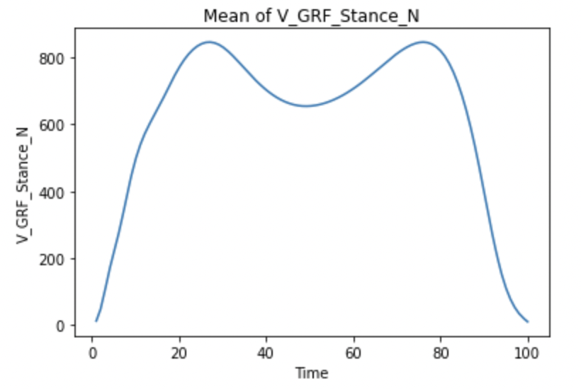
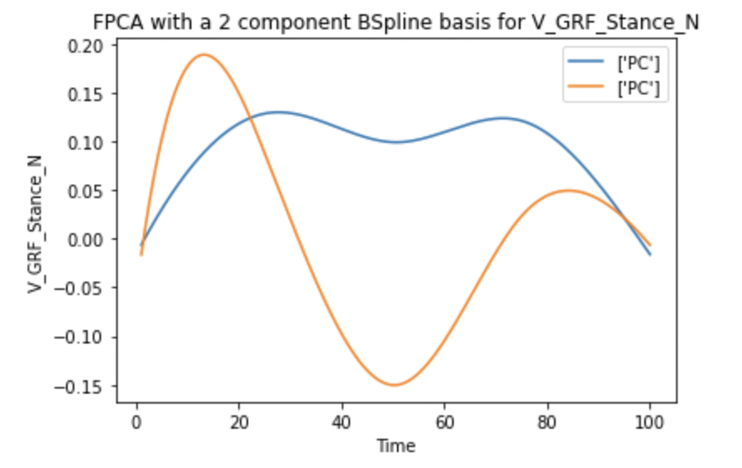
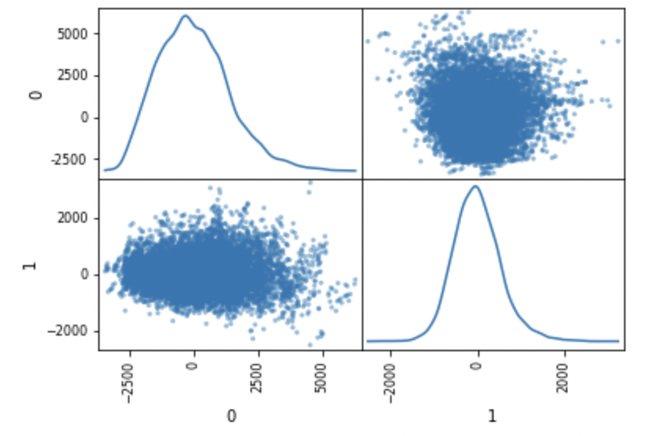
FPCA - V_GRF
Total Variance Explained | 93.3%
PC1 | 80.4%
PC2 | 12.9%
Notes:
This week we started off by fitting a univariate FPCA model with BSpline basis for all the variables of interest. We decided to fit a model that would explain atleast 90% of the variance in the data and we chose the number of components accordingly. Here, the first plot shows the mean of all observations of V_GRF, the second plot shows the functional principal components, the third plot shows a scatter plot matrix with distributions of the observations for the FPCs. The table on the right shows the total variance explained and the loading on the different components

Slide 3
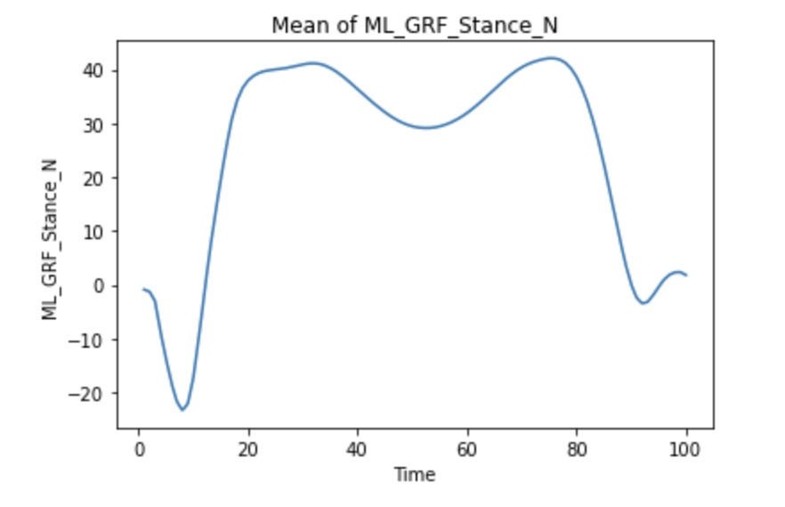
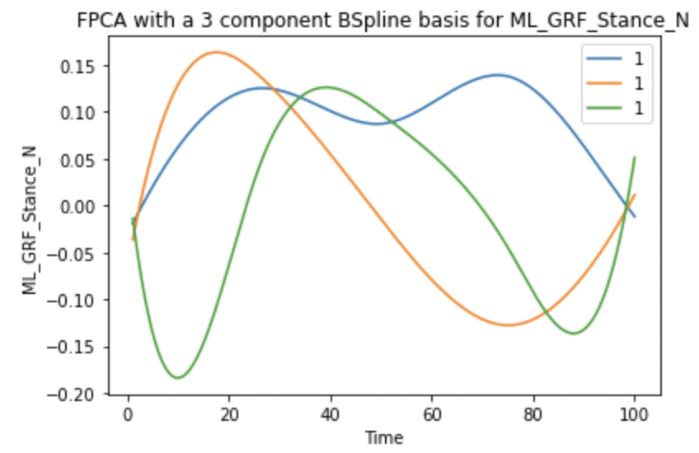
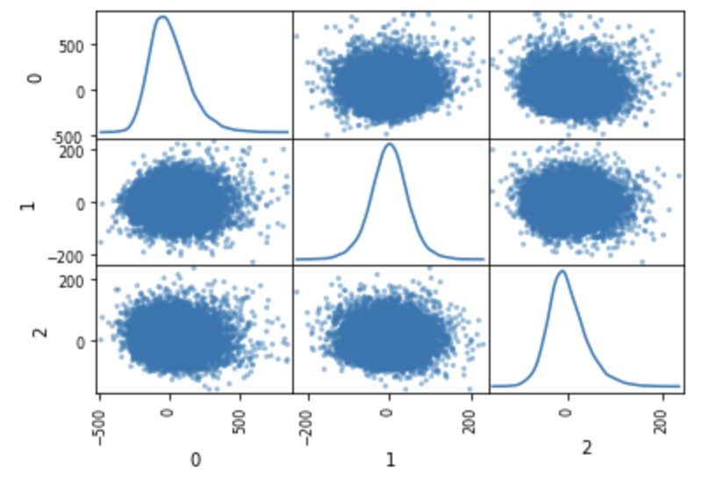
FPCA - ML_GRF
Total Variance Explained | 92.1%
PC1 | 77.5%
PC2 | 8.3%
PC3 | 6.3%
Notes:
For ML_GRF we needed 3 components to explain more than 90% variance. We see that the observations look like they are normally distributed (or slightly skewed in some cases) for different FPCs.

Slide 4
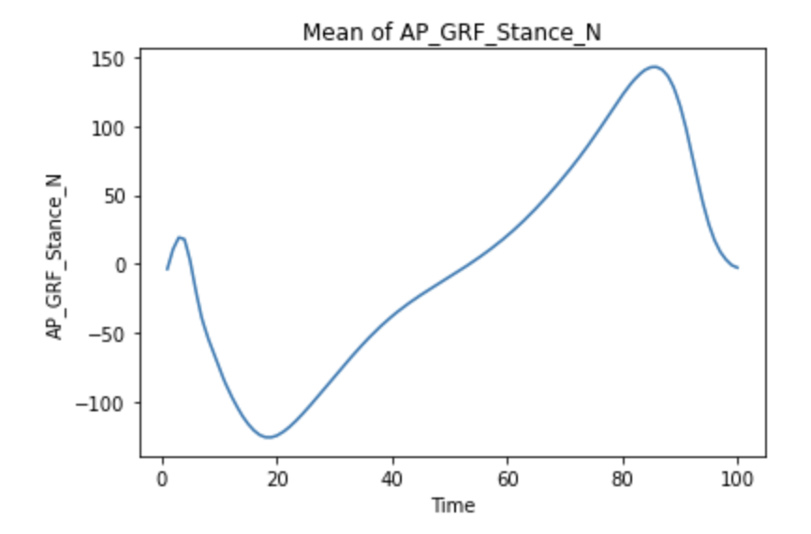
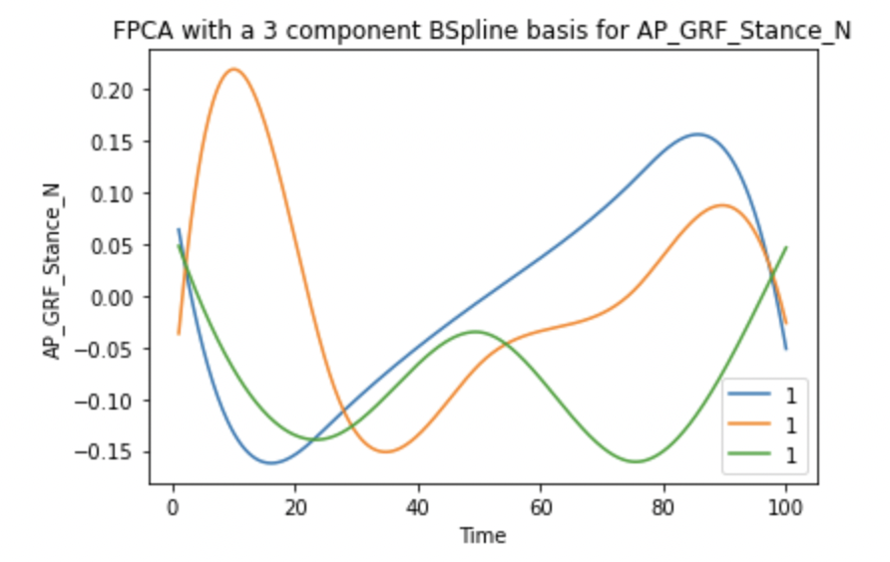
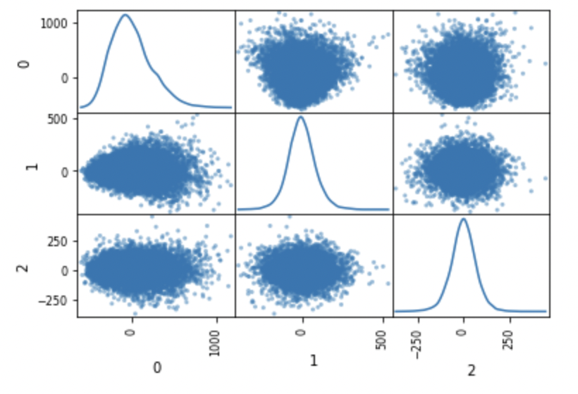
FPCA - AP_GRF
Total Variance Explained | 90.6%
PC1 | 74.9%
PC2 | 9.4%
PC3 | 6.2%
Notes:
For all the variables UFPCA results show that there is a heavy loading on the first component

Slide 5
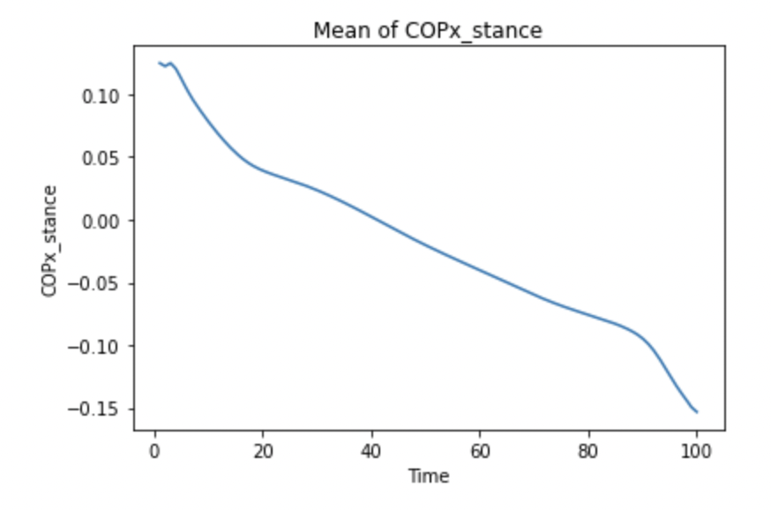
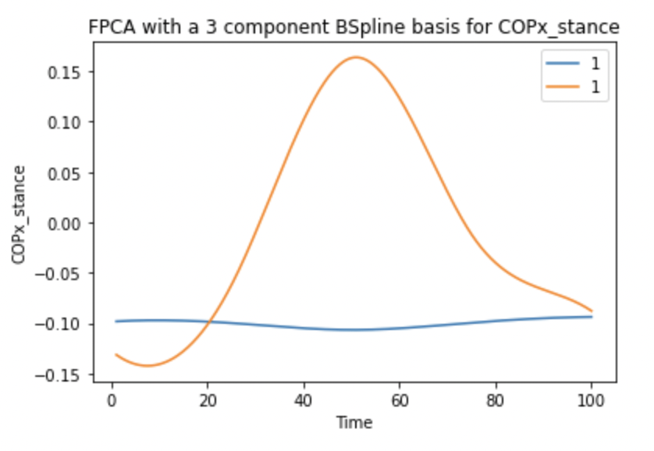
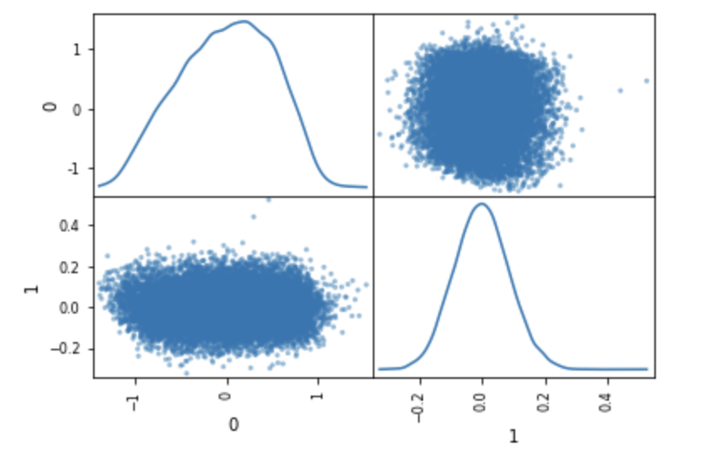
FPCA - COPx
Total Variance Explained | 97.0%
PC1 | 94.2%
PC2 | 2.8%
Notes:
For some variables we needed 2 components while for some we needed 3.

Slide 6
The End

Slide 7
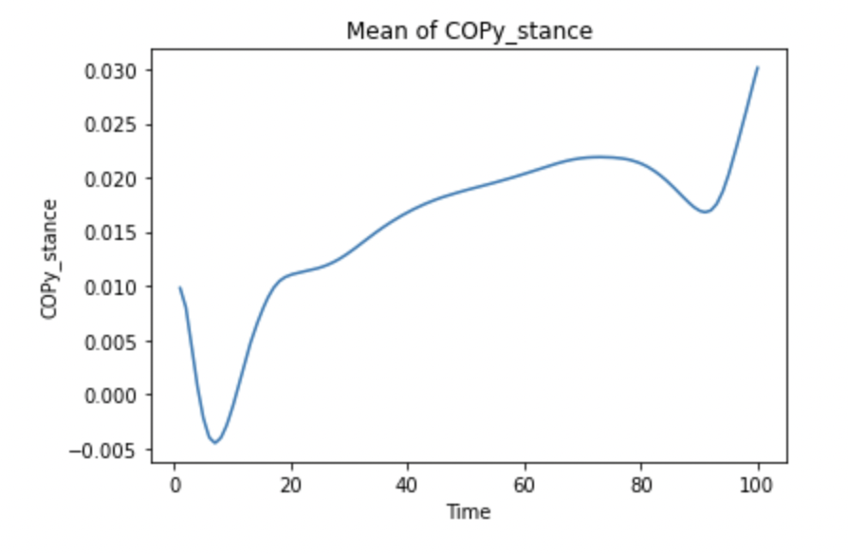
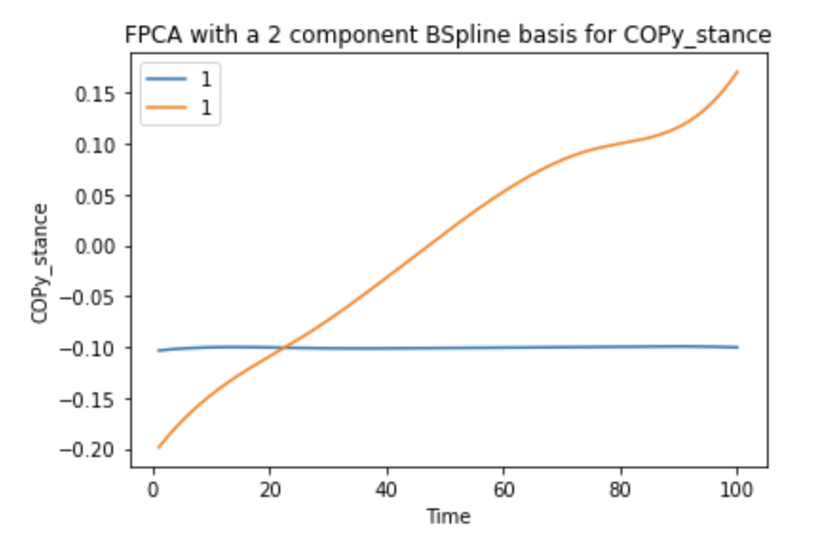
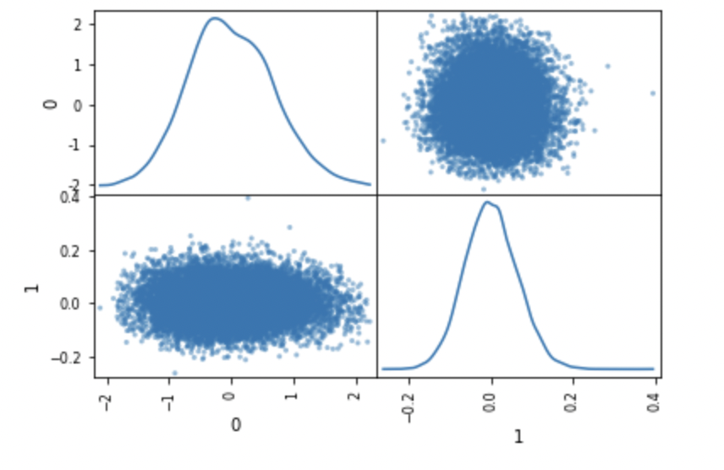
FPCA - COPy
Total Variance Explained | 99.6%
PC1 | 98.7%
PC2 | 0.9%
Notes:
For some of the variables we were able to get very high(almost 100%) Variance explanation with just 2 components.

Slide 8
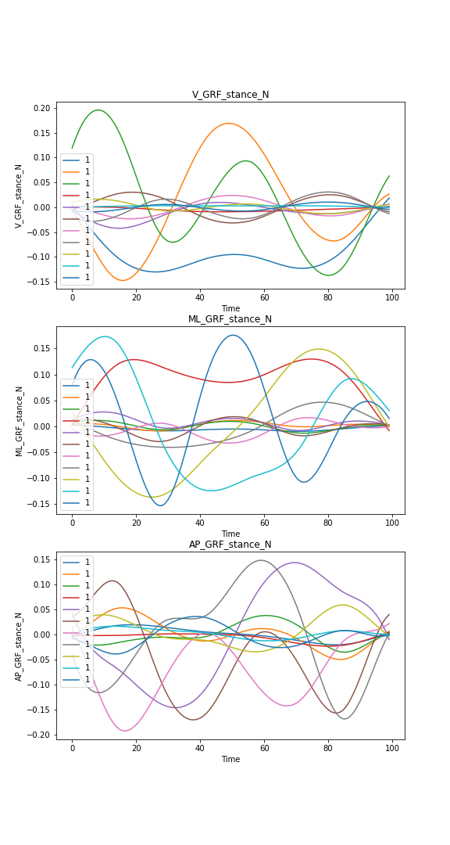
MFPCA - GRF
Notes:
Later on we tried Multivariate FPCA. Multivariate Functional Data consists of simultaneous variations of more than one random function. Since the 3 elements of GRF or 2 elements of COP in our data are just simultaneous variations along different axes of the same measure, we would be able to apply statistical techniques designed for MFD. MFPCA directly addresses any potential covariation between V, ML or AP elements in our data and thus is able to address any multicollinearity issues that might arise later in prediction modeling phase. While building an MFPCA model we can choose what %of variance we need the model to explain for each of the elements in the MFD and the model appropriately chooses the number of components required. When we specified that at least 95% of the variance needed to be explained for each element of MFD, the model outputted 11 components. The above graphs show how the 11 components vary for each of the elements in GRF

Slide 9
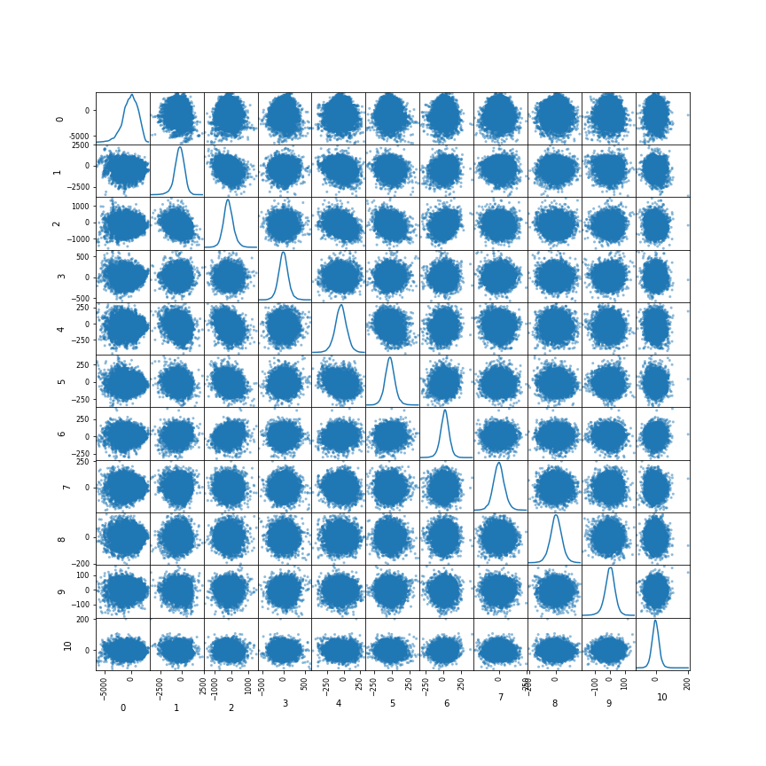
MFPCA - GRF - Scatterplot
Notes:
THe above plot shows a scatterplot and distribution of observations for each of the PCs. We observe that observations are normally distributed for most of the PCs.

Slide 10
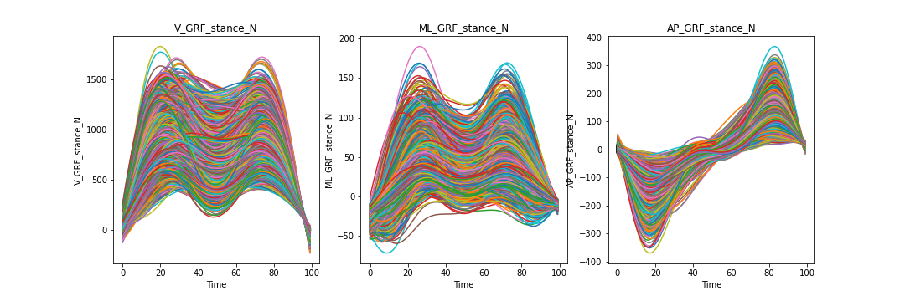
MFPCA - GRF - Reconstructed plots
Notes:
We then reconstructed our data using the MFPCs and we obtained plots very similar to our original plots.

Slide 11
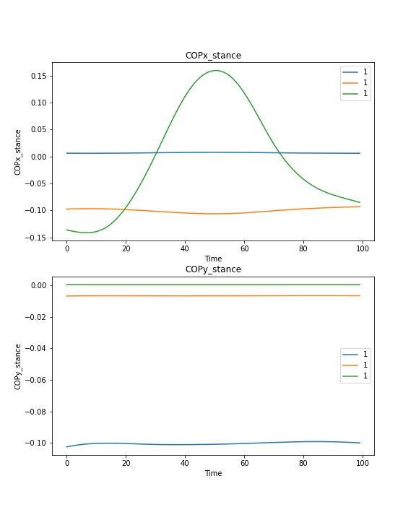
MFPCA - COP
Notes:
For COP, the model needed only 3 components to explain at least 95% of variance in both x and y elements.

Slide 12
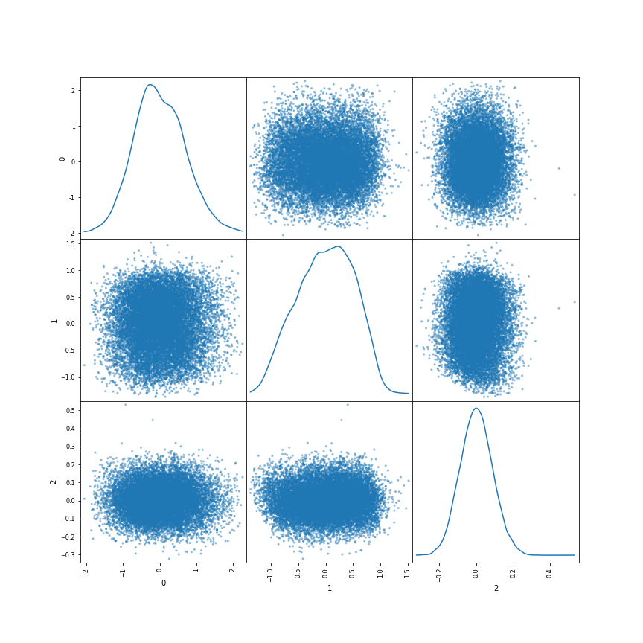
MFPCA - COP - Scatterplot
Notes:
The distribution plots look slightly skewed.

Slide 13
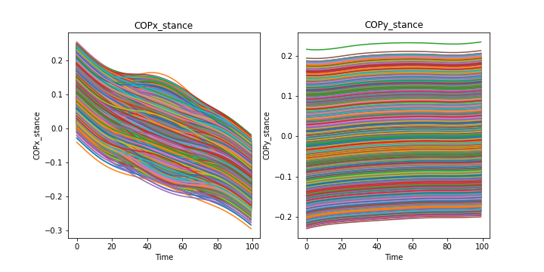
MFPCA - COP - Reconstructed plots
Notes:
The reconstructed plots again resemble original plots.

Slide 14
Goal and Next Steps
Refine and interpret the MFPCA model
Explore AutoEncoders
Notes:
We want to understand MFPCA better and we are currently reading up on the behind it. We still need to figure a way to calculate total variance explained and component loading and then refine our models.
Our ambitious target is to use AutoEncoders for dimension reduction and we will get started on this in the coming week!

